Slide 1
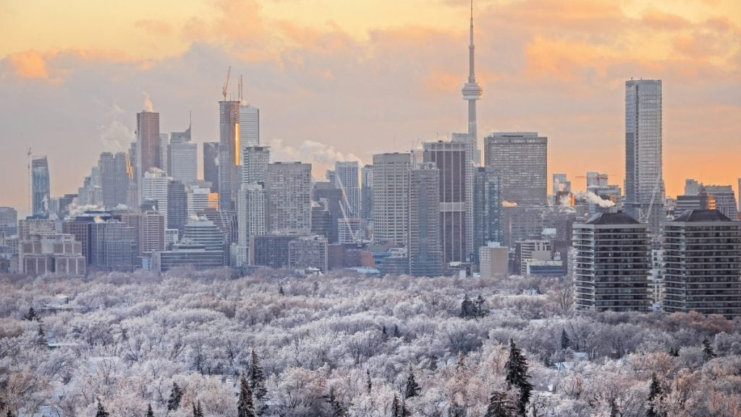
Optimizing Warming Center Operations:
A Data-Driven Strategic Approach
Maximizing Social Welfare Under Budget Constraints
MMA861: Analytical Decision Making
March 21, 2026

Slide 2







The Challenge: Extreme Weather Escapes Averages
Gut Feeling & Forecasts
Sudden -15°C Freeze
Planning for the "average" winter night leaves warming centers unprepared for sudden, severe temperature drops.
Unpredictable demand surges lead to catastrophic turn-aways and massive spikes in emergency room costs.
CURRENT STATE
THE RISK
OUR GOAL
Manual scheduling based on instinct rather than empirical probability with inflexible transferring.
Unpredictable freezes lead to massive emergency room costs and public crises.
Maximize social welfare without exceeding the strict $33,000 nightly budget limit by finding optimal staffing level.

Slide 3







Our Approach: A 3-Stage Data-Driven Framework
DATA FOUNDATION
Toronto City Open Data (Historical occupancy, weather probabilities, staffing costs)
STAGE 1: Estimate
STAGE 2: Optimize
STAGE 3: Stress-Test
Poisson-based
Monte Carlo
Simulation
Mixed Integer Linear
Programming (MILP)
Real-World
Stress Testing
Generating average demand for
warming centers under unexpected
weather conditions.​
Algorithmic optimization to balance budget constraints and human welfare.
Validating the optimized schedule
against unpredictable dynamic nightly
demand.​

Slide 4
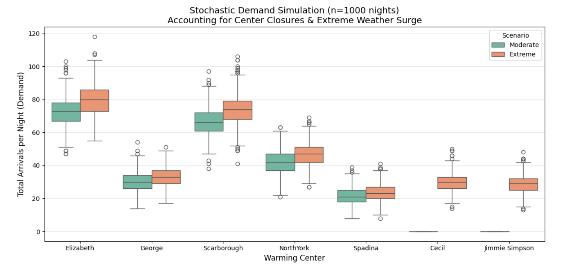



Stage 1: Capturing the Unpredictability of Human Traffic
Simulation Parameters
1,000 Monte Carlo Simulations
Using Poisson distributions to model
highly volatile, unpredictable nightly
arrival demand .​
Two Distinct Scenarios
Comparing Moderate (-5°C) baselines against Extreme (-15°C) catastrophic freezes.
Strict Business Rules
Cecil & Jimmie centers remain closed unless extreme freezes trigger at
-15°C.

Slide 5







Stage 2: Structuring the MILP Optimization Engine
The Balance of Priorities
Objective: Maximize Net Social Welfare
The mathematical optimization model evaluates millions of staffing
combinations to optimize total community benefit, rather than
simply minimizing operational costs.​
Core Assumption: Asymmetric Human Cost
The human cost of rejecting a vulnerable individual far exceeds the
logistical cost of transferring them. The model enforces a strict 4x
weighted penalty compared to admission for every turn-away. ​
Utility of Admission
4x Penalty for Turn-Aways
Strict System Constraints
$33,000: maximum nightly budget constraint
Absolute physical bed capacity limits
Mandatory 1:20 staff-to-guest compliance ratio

Slide 6


Stage 2 Output: The Optimal Staffing Plan
Optimal Staffing Allocation Scenario
Warming Center | Physical Capacity | Allocated Staff
Elizabeth | 75 beds | 4
George | 30 beds | 2
Scarborough | 68 beds | 4
North York | 46 beds | 3
Spadina | 22 beds | 2
Cecil (Extreme) | 30 beds | 2
Jimmie Simpson (Extreme) | 30 beds | 2
Total Expected Welfare
[117,276]
Optimized score prioritizing admission utility and minimizing rejection penalties within 4 transfers and 9 rejections under extreme scenario.
Expected Nightly Cost
$31,614≤ $33,000
Fully compliant with the strict nightly funding limit established by the city.

Slide 7
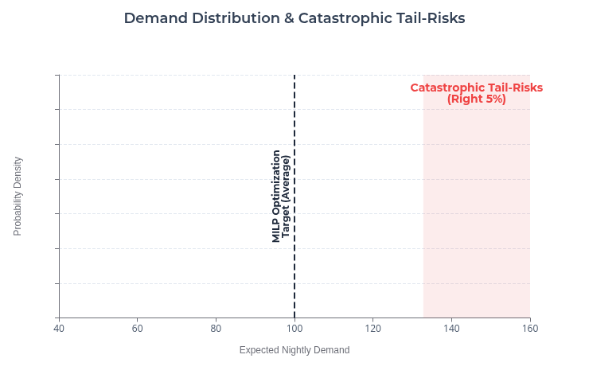



The "Flaw of Averages":
Why Theory Needs a Reality Check
Model Limitations
Optimizing for the Average
MILP is deterministic; it creates an optimal schedule based on the expected average demand.
High Real-World Volatility
Real-World demand does not follow
averages. Extreme freezes cause
unpredictable, catastrophic surges in
nightly demand.​
The Need for Stress-Testing
We must simulate this static schedule against unpredictable dynamic chaos to find its breaking point.

Slide 8
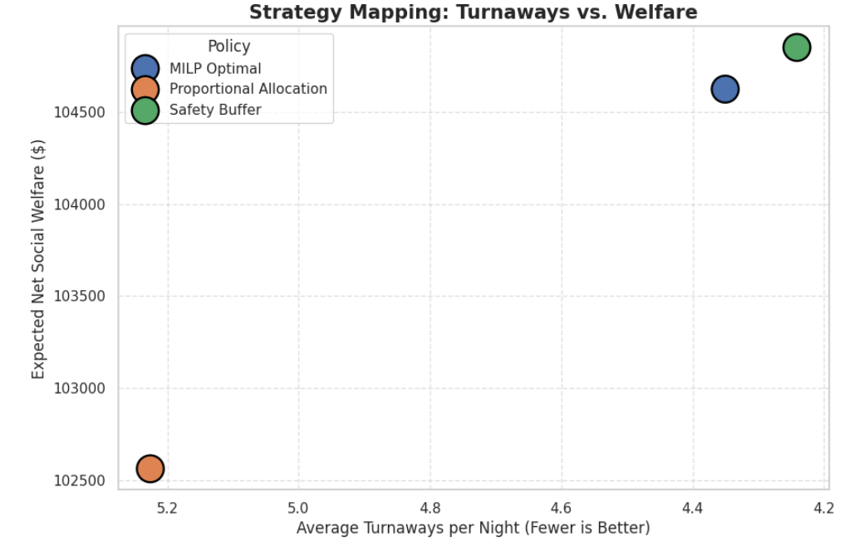



Stage 3: MILP Dominates "Gut-Feeling" Allocation
Stress Test Insights
5,000-Iteration Stress Test
Robust Monte Carlo simulation
simulating highly volatile and dynamic
scenarios.​
Locked Budget Constraints
Total budget strictly locked across all 3 benchmark policies:
(Safety Buffer, Proportional, MILP).
Winner: MILP
Proportional allocation is dangerous;
MILP minimizes rejections during uncertain scenarios.​

Slide 9





The Real Bottleneck: Infrastructure: Beds
Key Strategic Insight
The bottleneck is NO LONGER operational efficiency—it is capital infrastructure: Beds.
100% MAXED
Mathematical Limits Reached
Staff Availability is Irrelevant
Even the most advanced MILP optimization hits a physical brick wall. We cannot optimize beds that do not exist.
Under extreme weather, budget remains for additional staff, but physical capacity completely maxes out.

Slide 10
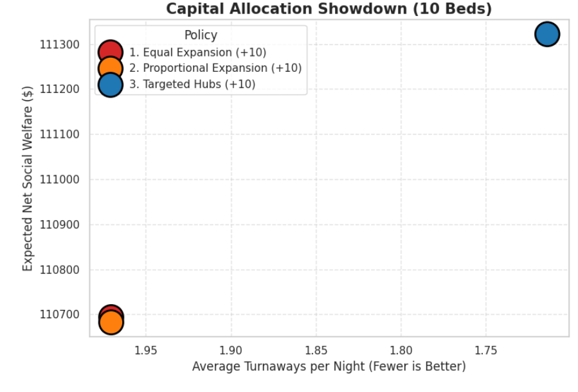

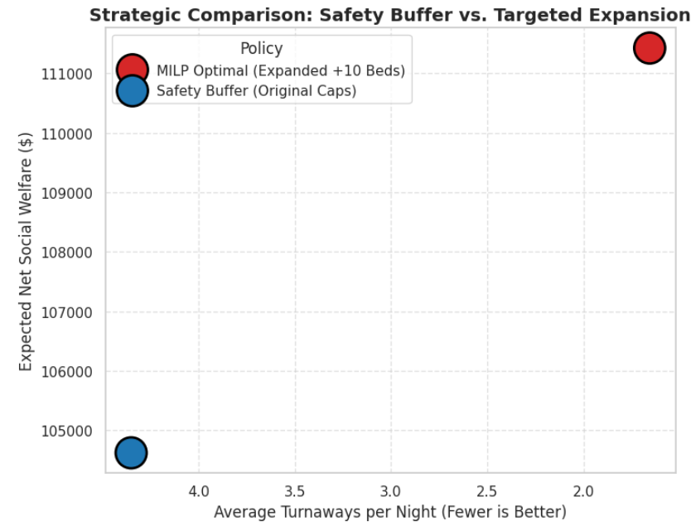


Strategic Pivot:
Targeted Expansion Drives the Highest ROI
Capital Distribution Impact
Best ROI
10 New Beds Available
Evaluating three methods for capital distribution: Equal, Proportional, and Targeted Hubs.
The Winner: Targeted Hubs
Allocating +5 beds to Elizabeth and +5 to Scarborough yields the best outcomes.
Impact vs. Baseline
Achieves a +5.7% increase in Welfare and a dramatic -67% reduction in turn-aways per night.

Slide 11






Final Roadmap & Recommendations
OPERATIONAL STRATEGY
FINANCIAL STRATEGY
Adopt the algorithmic staffing level to replace manual scheduling.​
Elizabeth: 4, George: 2, Scarborough: 4, North York: 3, ​
Spadina: 2, Cecil: 2, Jimmie Simpson: 2
Target all upcoming capital expansion (10 beds)
strictly toward ​
the Elizabeth +5 and Scarborough +5 centers.
THE ULTIMATE GOAL
Maximize budget, lower healthcare costs, ensure nobody is left in the cold.

Slide 12
Thank you!​
We are now open to your questions

Slide 13
Appendix
AI Disclosure: ​
Google Gemini and OpenAI GPT have been used for brainstorming, refining our optimization models, checking grammar, and paraphrasing sections for better flow. While AI tools assist in drafting our models, all core thinking processes, logic, and final wording and decisions are our own. Specific interactions and generated content utilized in this proposal are cited in the References section.
Reference:
OpenAI. (2026). Decision Model Review [ChatGPT]. Accessed Feb 28, 2026, https://chatgpt.com/share/69a4086d-e77c-800e-bff0-542ea22c06b3.
Google. (2026). Grammar Check & Paraphrasing for detail explanation and script [Gemini]. Accessed Mar 18, 2026, https://gemini.google.com/share/a545766d17ff.
Google. (2026). Poisson Demand Scenario Generation [Gemini]. Accessed March 19, 2026, https://gemini.google.com/share/a545766d17ff.
Google. (2026). Staffing Level Simulation using python [Gemini]. Accessed March 11, 2026, https://gemini.google.com/share/a545766d17ff.
Google. (2026). Bed Distribution Simulation using python [Gemini]. Accessed March 14, 2026, https://gemini.google.com/share/a545766d17ff.
Google. (2026). Gemini. Accessed March 18, 2026, https://gemini.google.com/app.
OpenAI. (2026). ChatGPT. Accessed March 18, 2026, https://chatgpt.com.
City of Toronto. (n.d.). Warming centres. https://www.toronto.ca/community-people/housing-shelter/homeless-help/toronto-warming-centres/
City of Toronto. (2025). Daily shelter & overnight service occupancy & capacity [Data set]. https://open.toronto.ca/dataset/daily-shelter-overnight-service-occupancy-capacity/
City of Toronto. (2024). Homelessness & shelter operator expression of interest. https://www.toronto.ca/community-people/community-partners/emergency-shelter-operators/expressions-of-interest/homelessness-shelter-operator-expression-of-interest/

